Slide 1

Ace of Hearts
Mia Giandinoto, Hannah Hagenau, Anna Johnson, Shivani Kulkarni, Dhruv Modi, Sherina Thomas, Matthew Tran
November 12th, 2020

Slide 2
Question and Purpose
Purpose | Source | Question | Importance | Interpretation
To determine heart rate variability in order to quantify stress To determine if a user is suffering from AMI (not completed during this phase) | Electrical impulses in the skin from the heart. ECG leads and electrodes placed in MCL-1 configuration | Is the subject experiencing high stress levels at this moment? | High stress is positively correlated to increased risk for AMI | HRV analysis using R-Peak detection

Slide 3
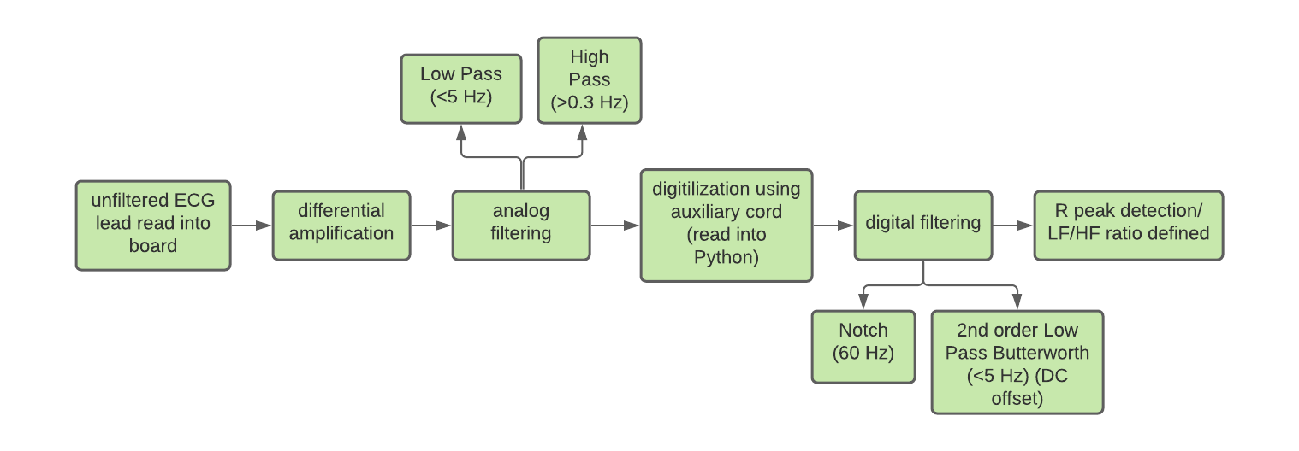
Overall diagrammatic model
Assumptions
Baseline reading is accurate Minimal movement interference Limited interference with electrode (no hair on chest, no sweat/lotion/powders, sticks well)

Slide 4
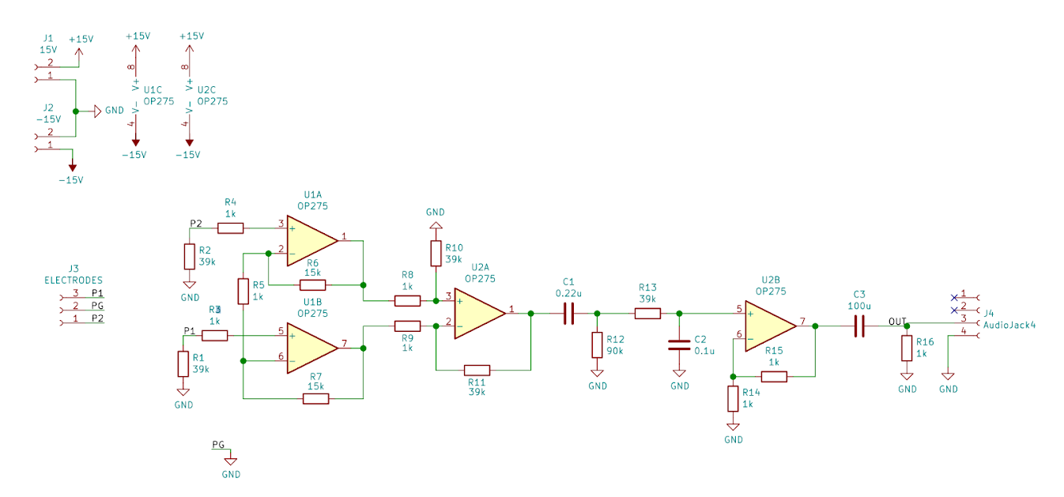
Circuit diagram
Lead
Inputs
Differential
High Low
Pass Pass
Filter Filter
Amplifier

Slide 5
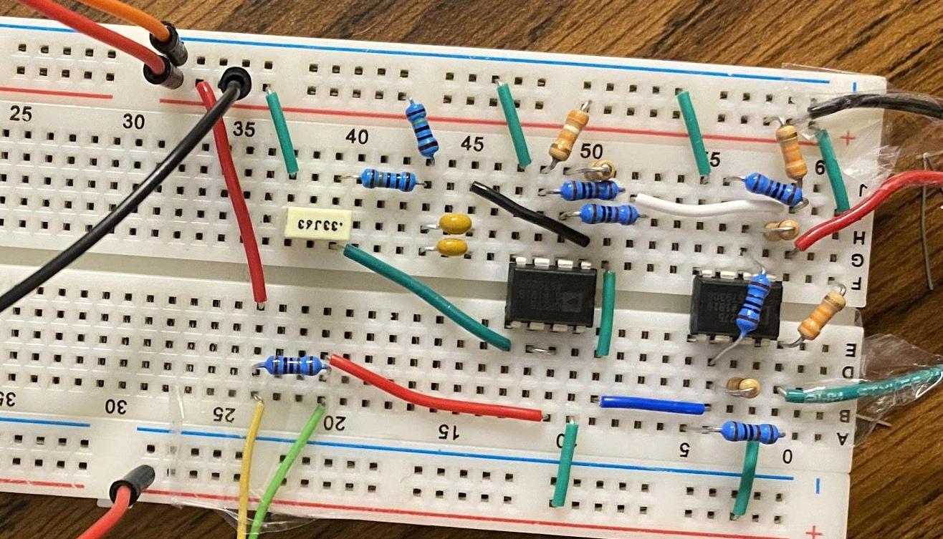
Actual Device
Operational Amplifiers
Ground Lead
Left Lead
Right Lead
Resistor Values
1k (x8)
15k (x2)
39k (x5)
90k (x1)
Auxiliary Ground
Microphone Input

Slide 6

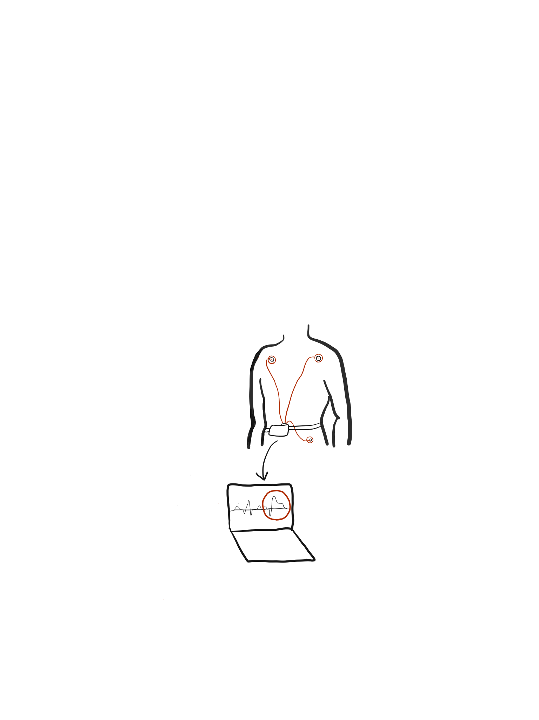
Device Signal Acquisition & Processing
Portable ECG

Slide 7
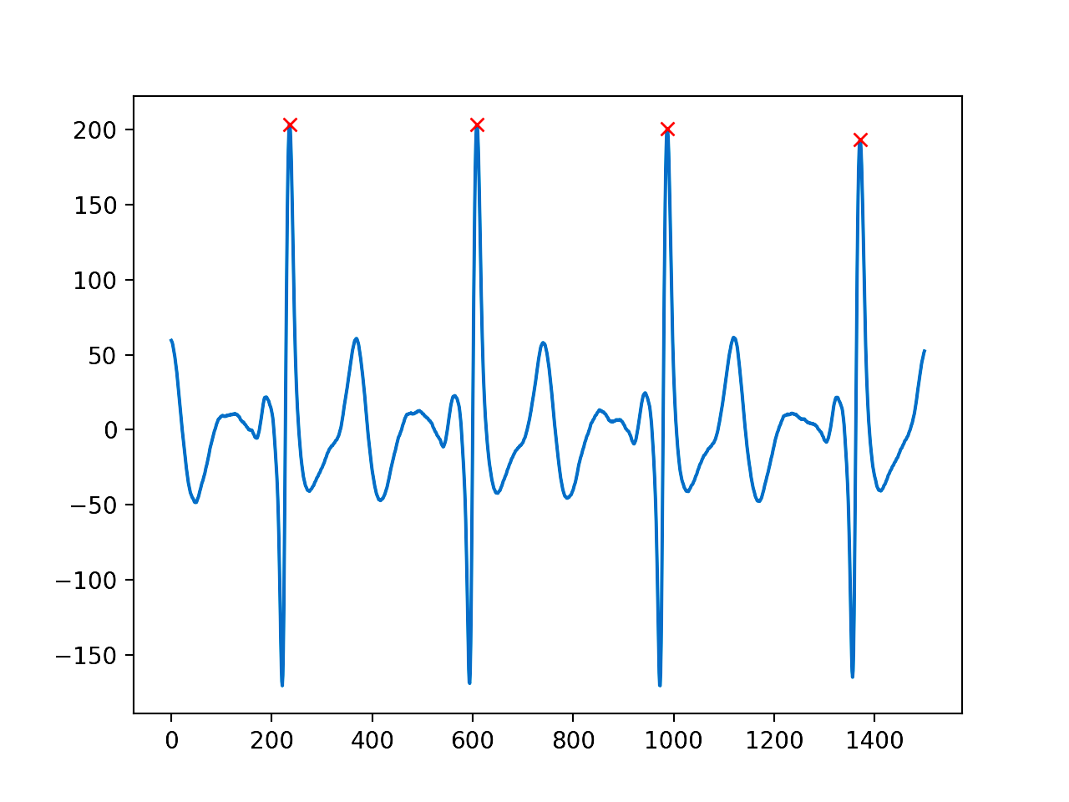
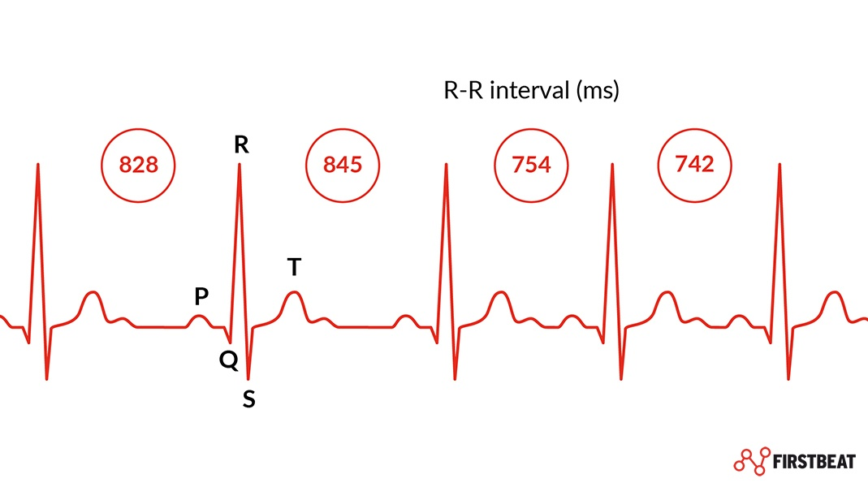
Signal Verification
Applied Filters
Analog Low (<5 Hz) and High Pass (>0.3 Hz) Digital Notch filter (60 Hz) Digital Butterworth (<5 Hz)
Time (s*500)
Time (s*500)

Slide 8
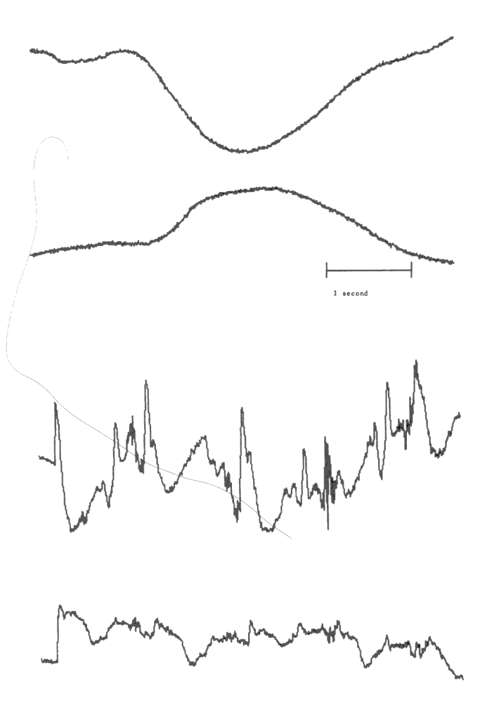
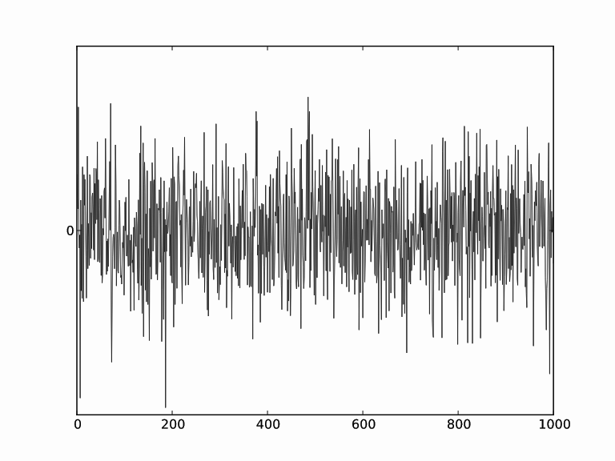
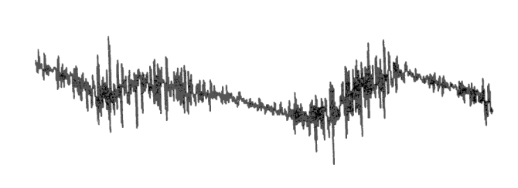
ECG Noise⁴
Baseline Wander
Muscle Noise (EMG)
Powerline interference
Electrode Motion Artifact
Notes:
Wavelet = baseline

Slide 9
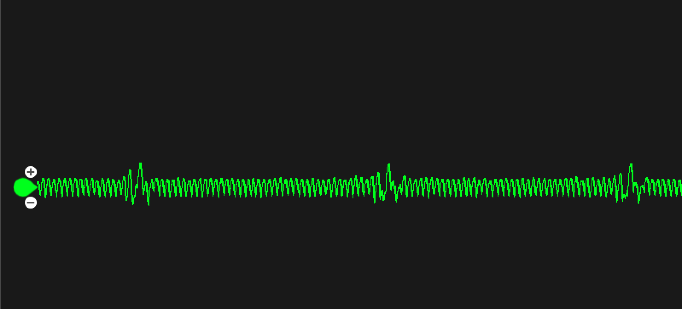
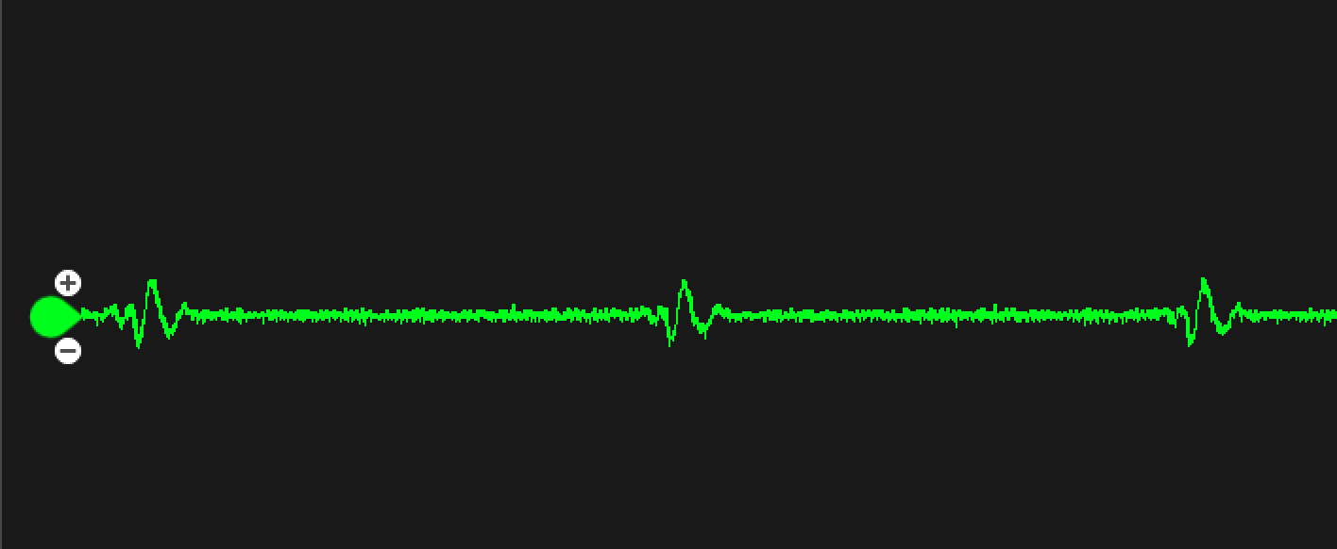
Effects of Powerline Interference
With Powerline Interference
Without Powerline Interference

Slide 10
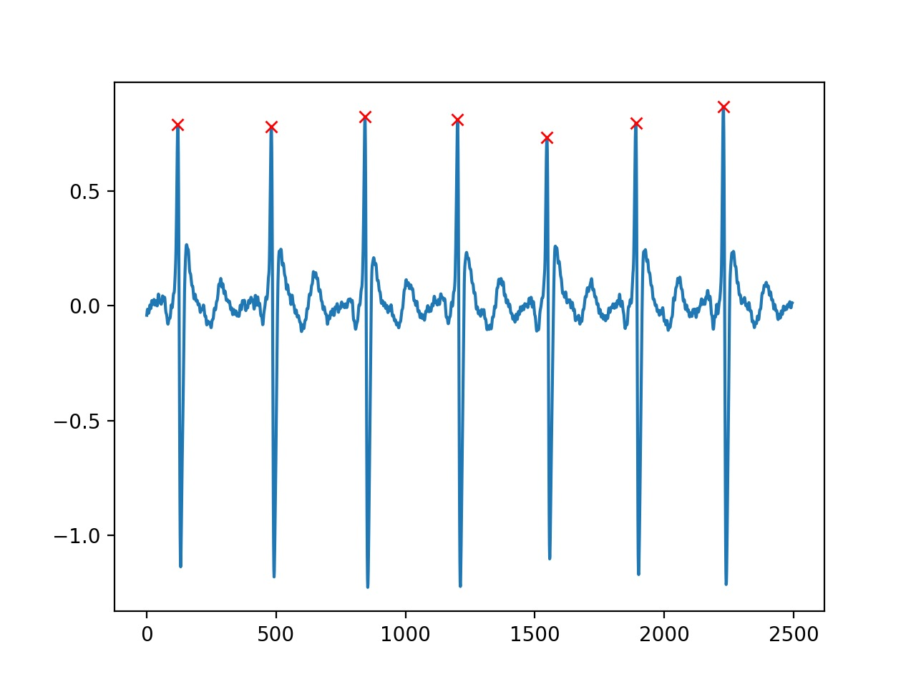
Signal Analysis
Signal recorded at 44,100 Hz, downsampled to 500 Hz and
R-peak detection using find_peaks function w/ Partial Wavelet Reconstruction
Time (s*500)

Slide 11
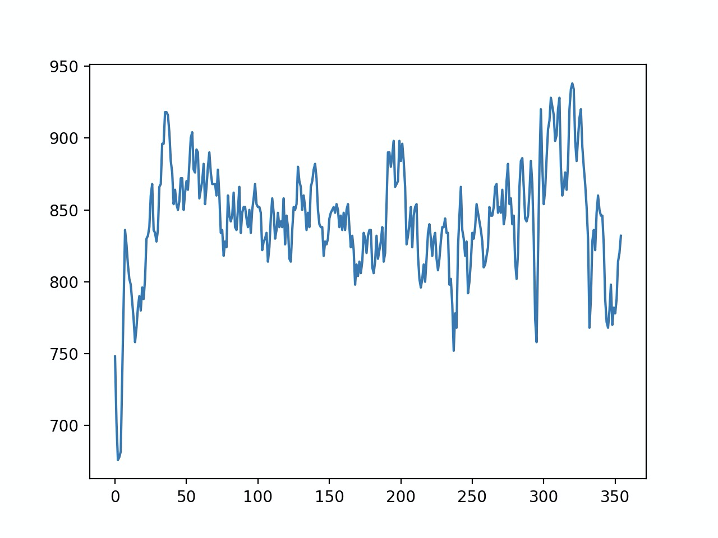
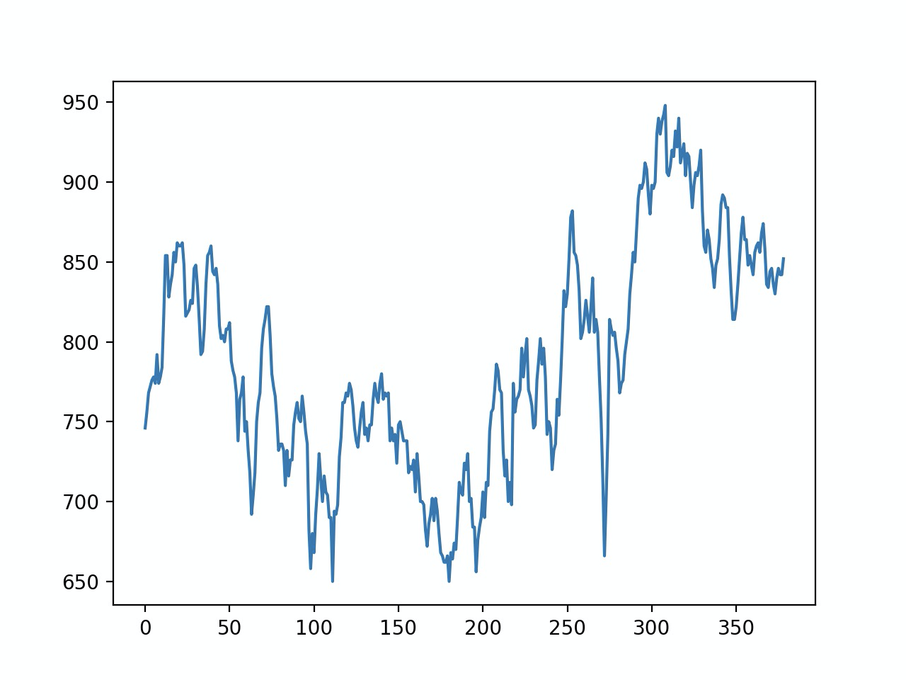
HRV Stress Test
Unstressed
Results:
T-Test: stressed values are significantly greater than unstressed values
t=3.19
p<0.05
RR Interval
Unstressed | Stressed
2.557 | 6.077
2.142 | 4.332
2.209 | 3.610
Time (sec)
Stressed
RR Interval
Time (sec)

Slide 12
Improvisation
Bypassing the Arduino (using headphone jack) | Additional Parts | Analog filtering | Digital Filtering
More effective data transfer to code Read directly into python More controlled sampling rate Eliminates middle steps | Resistors (39K and 15K) Op Amps (OP275) | High pass (DC offset→ baseline wander) Low pass | Addition of a digital notch filter and 2nd order Butterworth filter

Slide 13
Insights Gained
You can gain additional noise from the room.
-Test the device in multiple different types of environments(different buildings, and outdoors)
Movement can have a large impact on signal analysis and can cause the HRV code to error so we will need to do further tests to determine the best way to minimize interference by movement.

Slide 14
Next Steps
Next Steps: Phase IV
1. AMI with Neural Network | 2. Bluetooth | 3. Real time signal read/analysis
Train and utilize the neural network for AMI detection | Creating circuit adaptation Reading into headphone jack | Read in signals in real time for immediate signal analysis
How we are going to test the device:
Continue to do stress tests with different variations of stressors and subjects to build our own database.
Introduce noise to further test filters
Find a way to simulate an AMI to test the neural network

Slide 15
References
Differential Amplifier - The Voltage Subtractor. (2020, March 17). Retrieved November 11, 2020, from https://www.electronics-tutorials.ws/opamp/opamp_5.html
Harden, S. W. (n.d.). DIY ECG with 1 op-amp. Retrieved November 11, 2020, from https://swharden.com/blog/2016-08-08-diy-ecg-with-1-op-amp/
Kim, H.-G., et al. (2018). "Stress and Heart Rate Variability: A Meta-Analysis and Review of the Literature." Psychiatry Investigation 15(3): 235-245.
Moody GB, Muldrow WE, Mark RG(1984). “A noise stress test for arrhythmia detectors.” Computers in Cardiology 11:381-384.
Nunan, D., et al. (2010). "A Quantitative Systematic Review of Normal Values for Short-Term Heart Rate Variability in Healthy Adults." Pacing and Clinical Electrophysiology 33(11): 1407-1417.
Villegas, A., Mceneaney, D., & Escalona, O. (2019). Arm-ECG Wireless Sensor System for Wearable Long-Term Surveillance of Heart Arrhythmias. Electronics, 8(11), 1300. doi:10.3390/electronics8111300
Shaffer, F. and J. P. Ginsberg (2017). "An Overview of Heart Rate Variability Metrics and Norms." Frontiers in public health 5: 258-258.

Slide 16
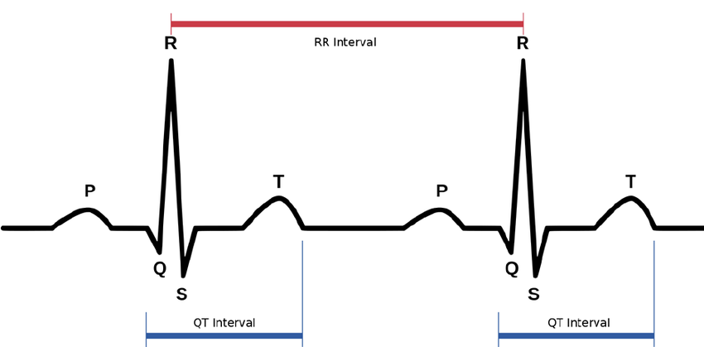
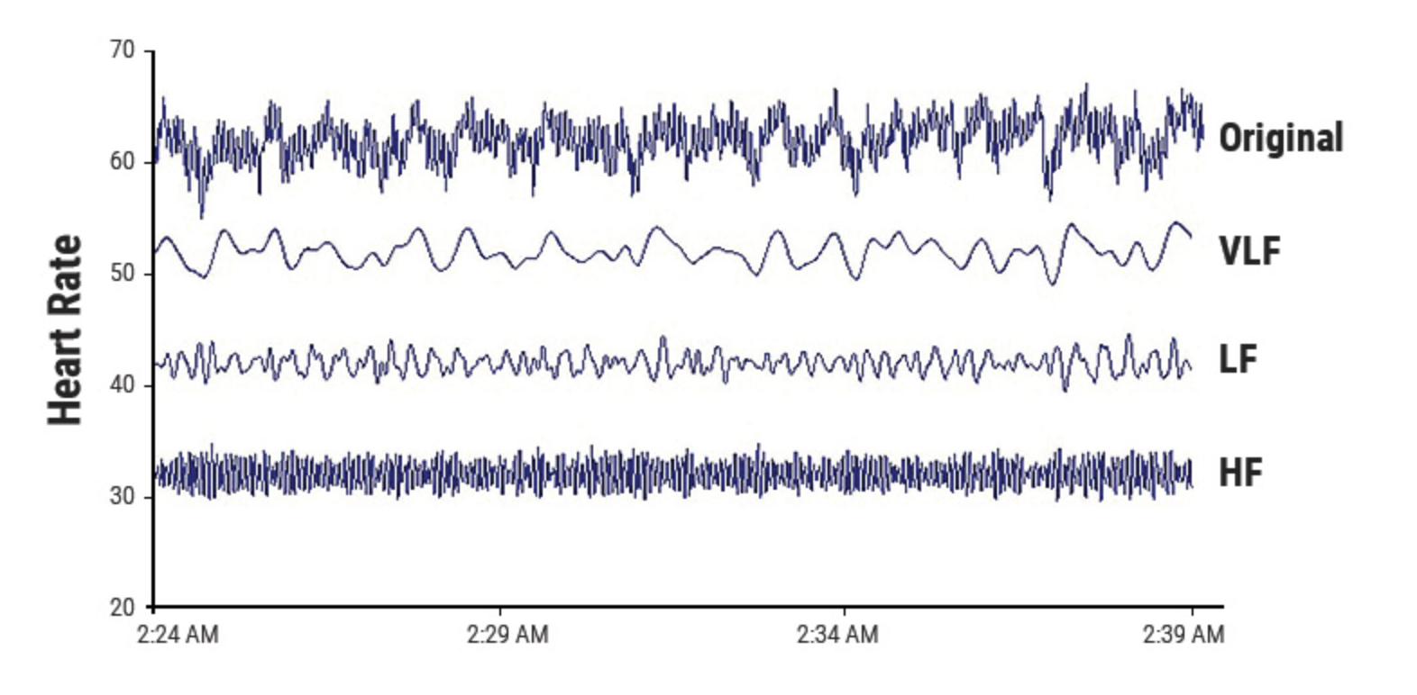
HRV Supplemental
ECG→R peak detection→ RR Intervals → Tachogram→ FFT and Power Spectral analysis→ Analysis
LF ranges from 0.04-0.15 Hz⁷
PNS, SNS, and BP regulation
HF ranges from 0.15-0.4 Hz⁷
parasympathetic/respiratory activity
Low power reflects stress
LF/HF Ratio
Reflects balance between SNS and PNS⁷
Increase in LF/HF ratio associated with high levels of stress(5 min recordings)³
Power Spectral Analysis to determine LF and HF power
https://www.physiospot.com/research/why-physical-therapists-can-use-heart-rate-variability-hrv-as-a-measurement-tool/

Slide 17
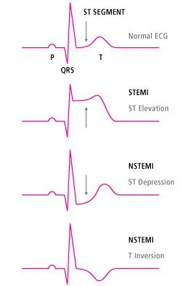
ECG Supplemental
Voltage over time of electrical signals within the heart
Signs of myocardial infarction:
ST elevation
ST depression
T wave inversion

